Slide 1
“Keith, you have got to read some Fred Schauer on defeasible rules”
RONALD P. LOUI
COMPUTER SCIENCE
UNIVERSITY OF ILLINOIS SPRINGFIELD
MAY 8, 2013

Slide 2
FOUR PATHS TO DEFEASIBILITY
For Keith Miller’s Retirement
Précis of a longer piece published in Peter Boltuc's Philosophy and Computing APA Newsletter 2013

Slide 3
When I first got here…
I suggested to Keith that we collaborate
I told Keith that he really needs to read my guy, Fred Schauer,
  on defeasibility and law
He replied that I really need to read his guys, Arkin and Asaro,
  on RoboEthics
Touché, Keith Miller
Since I couldn't convince Keith on the first day,
  I will try again on his last day

Slide 4
Frederick Schauer is someone…
whose opinions I care about:
(leading Constitutional Law Scholar)
(former Dean of JFK School of Government)
but he wrote something last year that seems treasonous to me:
  “Is Defeasibility an Essential Property of Law?”

Slide 5
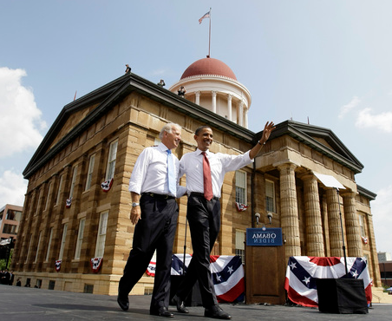
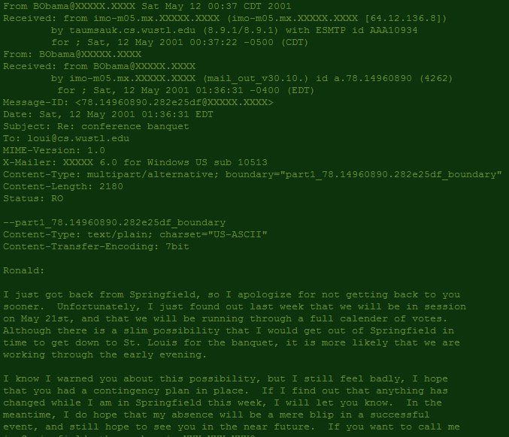
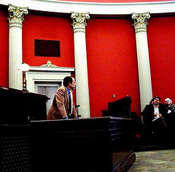


Original ICAIL 2001 Speaker
Hurd v. Rock Island Railroad
Abe Lincoln: Vampire Hunter

Slide 6
Not Essential But Desirable
Schauer actually finds room for defeasibility in a legal system
He permits ethics to override the logic and language of law
  on rare occasion
If a legal system is truly justice-seeking,
  it should be possible for common sense to override rule of law

Slide 7
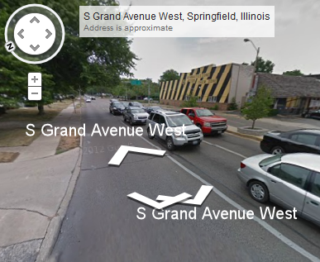
Thanks to Keith Miller,
we live in the city near a beautiful park
just off Route 66!
That's not the way we see things in my former research community:
  Artificial Intelligence and Law
Defeasibility became essential to our work --
  because even for a computer, logic is too rigid
The way we see things,
  those who like Fuzzy Logic,
  are just on their way to Defeasible Logic
  like the Springfield stop on the way to Barstow and San Bernardino

Slide 8
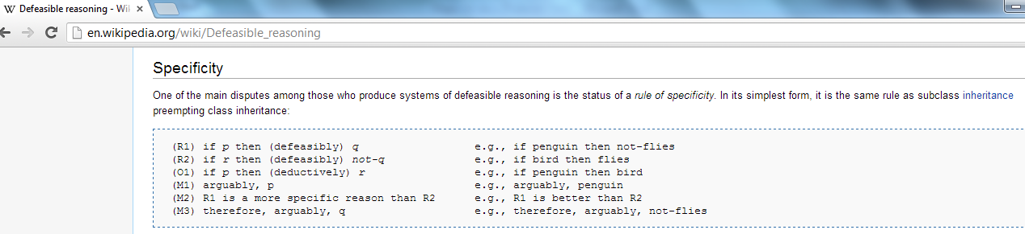
What it is

Slide 9
“Indefeasible!”
We can go back in history (a.k.a., South on Sixth):
James Madison's Declaration of Rights,
  “community hath an indubitable, inalienable, and indefeasible right...”
John Adams,
  “The people have a right, an indisputable, unalienable, indefeasible, divine right...”
Among secessionists, the more you hated Abe Lincoln, the more "indefeasible" your state rights seemed

Slide 10
“Indefeasible!”
"indefeasible" was once a powerful word because rules were normally defeasible
In recent years, the situation has reversed
"defeasible" is the powerful word because we must remind ourselves
  that we owe our highest allegiance to ethics and reason,
  not to the rigidity of rule encodings

Slide 11
So how does the computer programmer get drawn to defeasibility?

Slide 12
ONE:
CONVENTION: RULE QUALIFICATION, RULE EMENDATION, AND RULE PRIORITY
It is simply an empirical fact that rules are asserted,
  then are amended with qualifiers and undercutters
Logical form should follow natural language form
As a trump card,
rules in judicial systems are produced within jurisdictions,
  and higher courts defeat lower courts

Slide 13
TWO:
ASSERTION AND ARGUMENTATION: A THIRD TRUTH VALUE
How should we characterize the force of an argument’s conclusion?
  True?
  Assertible?
  Provisional?
  Fallible and Corrigible?
  Not yet Negated or Rebutted?
  The output of a rule schema, which may be demoted through counter-argument?
This is what we mean
by “defeasible”!

Slide 14
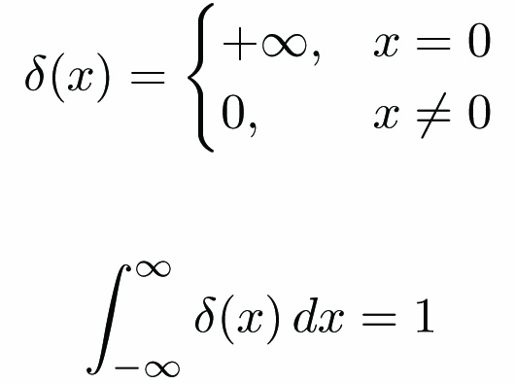
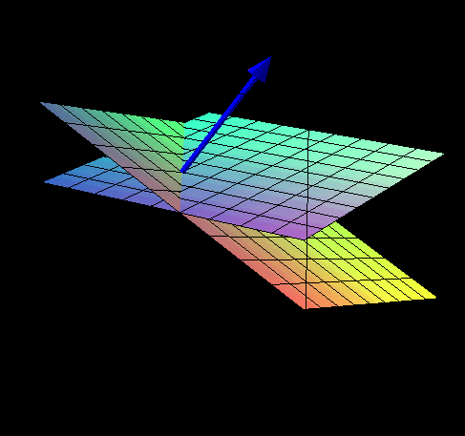
THREE:
LANGUAGE: THE LAZY LEARNING OF OPEN TEXTURE, INCOMMENSURABILITY OF LANGUAGE, ELISION OF DETAIL, AND LEGISLATIVE COMPROMISE
Imagine cutting planes in high dimensional space
  that separate positive from negative examples
  but are not well defined, on first linguistic encounter
The speaker and hearer understand that further distinctions will be made
  as hard cases arise
Some think lazy speaker, lazy predicates
  But are mathematicians lazy?

Slide 15
FOUR:
REASON: ANALOGICAL REASONING FROM PRECEDENT
Over in Indiana,
  their version of Keith Miller
  is a guy named Doug Hofstaedter
Doug Hofstaedter is getting loud again these days
Not about his famous book, Goedel, Escher, Bach,
but about analogical reasoning
Analogical reasoning is a form of defeasible reasoning!

Slide 16
Go Away
(To The Secessionists, Not Keith Miller!)
It may sound like Secessionist language, but
my support for defeasibility
remains
  indisputable,
  unalienable,
  and INDEFEASIBLE!

Slide 17
Supplemental Slides

Slide 18
I once asked Scalia…
Regarding precedent and analogy:
“Do you really think there must be precise agreement
  on the meaning of the Constitution,
  when it would suffice that there is (meta-)agreement
  on how to resolve disagreements
  on the meaning of the Constitution?“
He responded, "yes,"

Slide 19
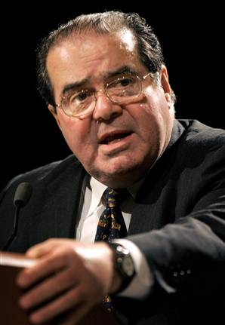
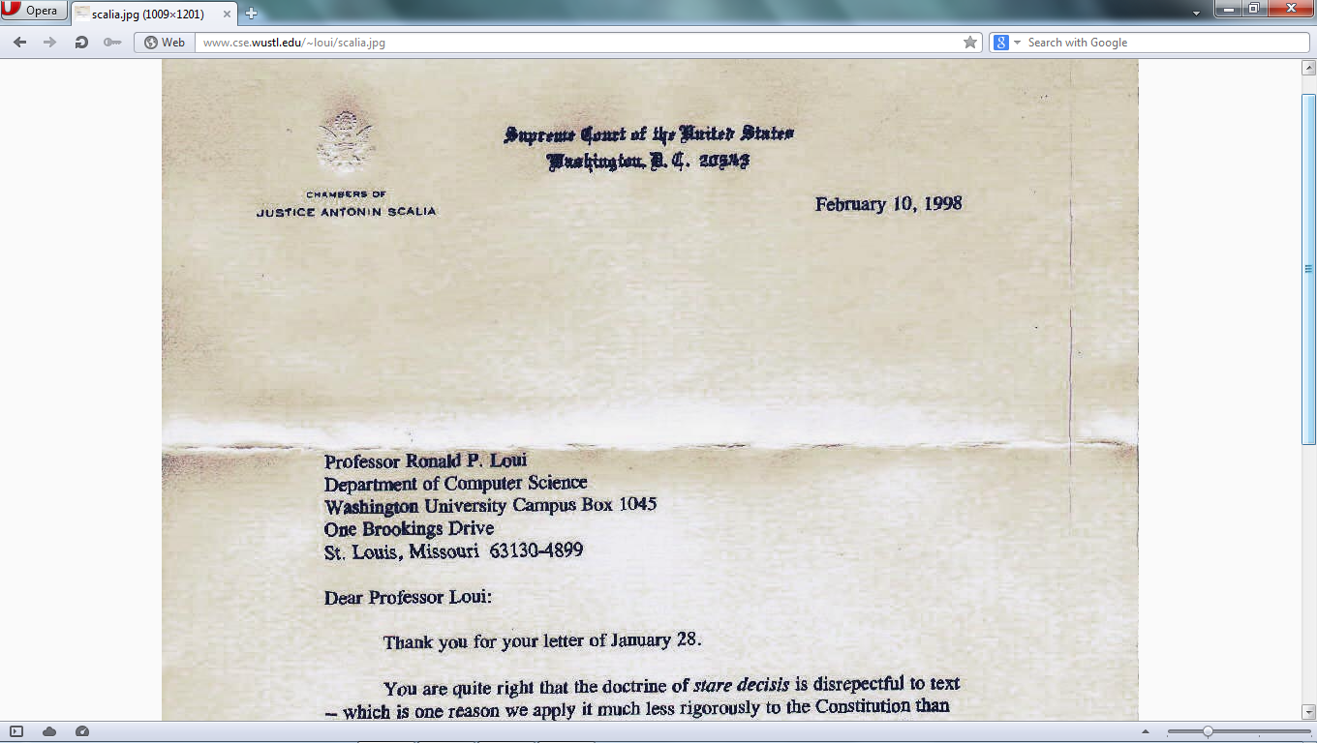
I once asked Scalia…
but that answer paradoxically undercuts the authority of his own answer,
since his authority as Supreme Court Justice
is to resolve disagreements on the meaning of the Constitution!

